Slide 1


Slide 2


BBDW Best Practices
in Multi-Source Data Aggregations for BI
John Schwass
WWF, Senior Director, Fundraising Operations & Analytics
Alan Eager
Blackbaud, Cloud Data Architect, Advisory – Solutions R&D

Slide 3
Agenda
John
Introduction
Reporting Goals & Principles
Implementation Approach
Data Integration
Alan
Design, BA & Review Processes
Multi-Source - Technical Context
Development & QA Processes
Deployment Processes

Slide 4


Divider Slide Subtitle for divider slide
Introduction
WWF & Blackbaud CRM

Slide 5




About
OFFICES & STAFF
MEMBERSHIP
PROJECTS
13,000 projects since 1961 2,000 current projects in 100 countries
80 offices 100 countries
6,200 staff
5 million+

Slide 6
Blackbaud CRM Implementation
Selected to replace Team Approach
Used SAS to email reports and publish to Web Reports Studio
All reports run from daily replication of production database
Primary goals:
Improve high-touch prospect management – individuals, foundations, corporations as well as policy and government affairs
Facilitate better integration with online fundraising - Luminate Online and custom online giving center

Slide 7
Divider Slide Subtitle for divider slide
Reporting Principles

Slide 8
Reporting Principles
All the information in the “right” place
Reporting pages for each team
All reports for the team are on the team reporting page, so common reports are referenced from multiple pages
Reports in their “natural” places using alter existing pages
Constituents, opportunities, events, campaigns etc
Reports integrate with the system & facilitate business processes
Expand the system via custom specs, avoid SSRS
Use links to ease system navigation and promote use
Use actions to facilitate business processes and to make data correction easy
Use UIWidget links to integrate summary and detail views of the data

Slide 9
Divider Slide Subtitle for divider slide
Implementation Approach

Slide 10
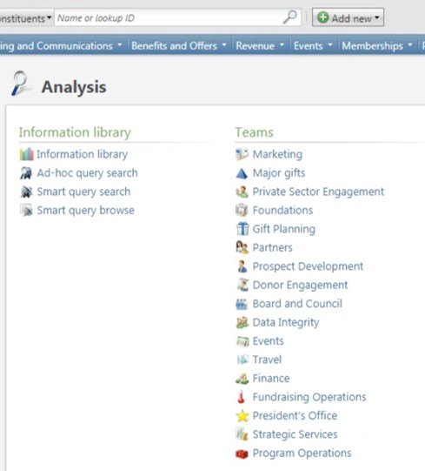
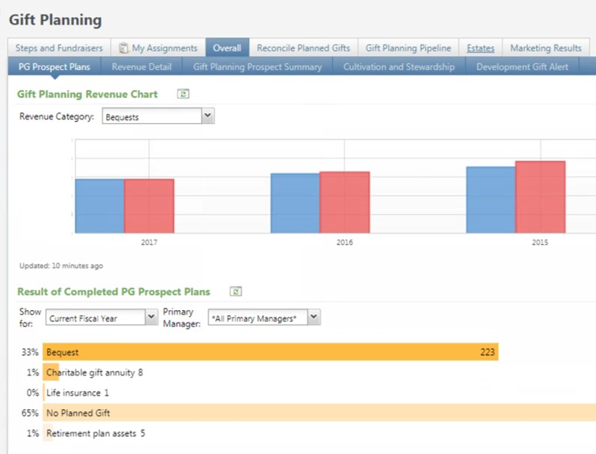
Team Pages

Slide 11
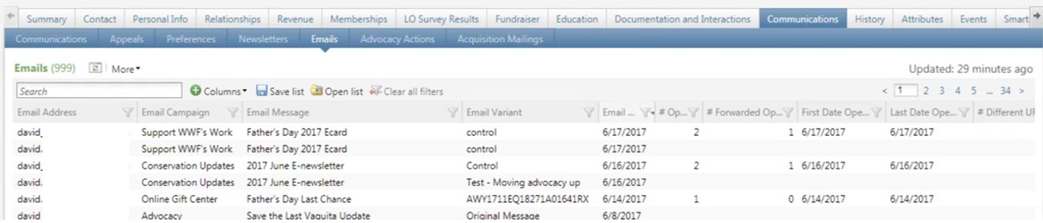
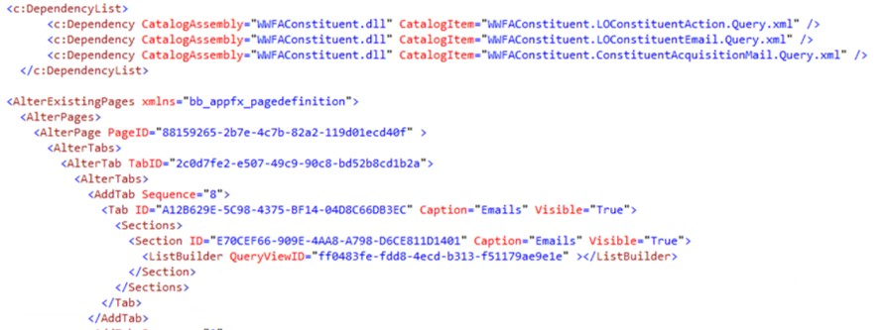
Reports/Lists on Existing Pages

Slide 12
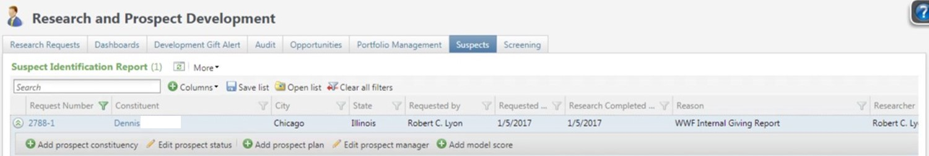
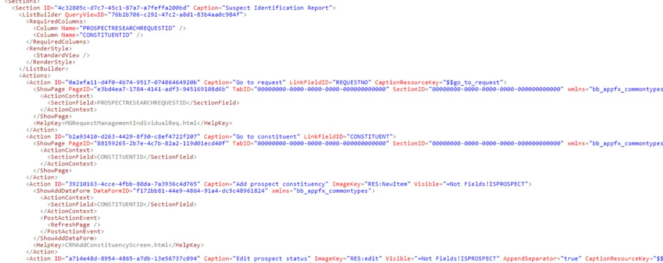
Links, actions and list builders

Slide 13
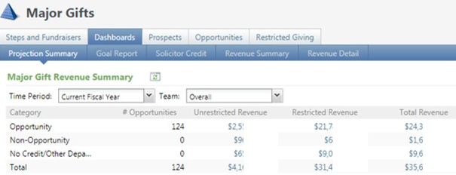
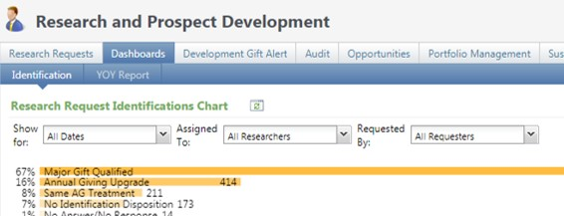

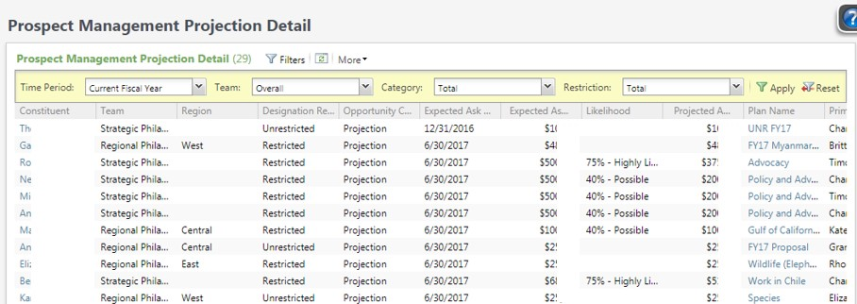
Summary to detail

Slide 14
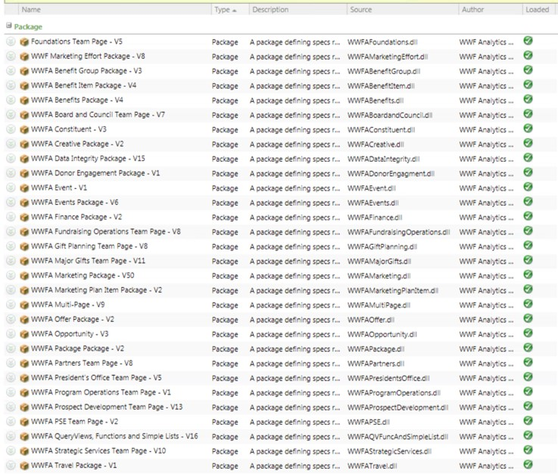
Implementation Organization
Each team page has its own project & package
Each existing Blackbaud CRM page with customizations has its own project & package
Project/package for specs referenced by multiple team pages
Project/package for functions, views, simple data lists

Slide 15
Divider Slide Subtitle for divider slide
Data Integration
Luminate Online & Hyperion

Slide 16
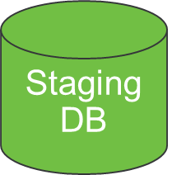

Data Integration
Check FTP site for unloaded flat files,
Load files to Staging DB
DW Load SSIS Package
Check Staging DB for unloaded files, Load files to DW
Staging DB
Flat File Load SSIS Package
DW

Slide 17
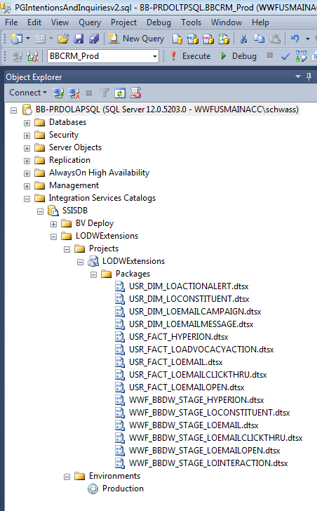
Deployment
SSIS Packages deployed via Integration Services Catalogs
Schedule to run daily, independent of Blackbaud DW refresh process
Added ALTERNATELOOKUPID table as custom table extension to Blackbaud DW, facilitating link between Luminate Online contact IDs and Blackbaud constituent IDs

Slide 18
Divider Slide Subtitle for divider slide
Summary &
Next Steps

Slide 19
Summary & Next Steps
All the information in the “right” place
Reports integrate with the system & facilitate business processes
Seamlessly integrate external data sources into CRM by using Blackbaud data warehouse as the integration point
Next data sources: data model scores, surveys & Oracle Financials
Use mapping functionality to create team maps for “likely” prospects
Develop executive-level dashboards

Slide 20
Divider Slide Subtitle for divider slide
Design Processes
Tools & Techniques

Slide 21
BBDW Best Practices
in Multi-Source Data Aggregations for BI
John Schwass
WWF, Senior Director, Fundraising Operations & Analytics
Alan Eager
Blackbaud, Cloud Data Architect, Advisory – Solutions R&D

Slide 22

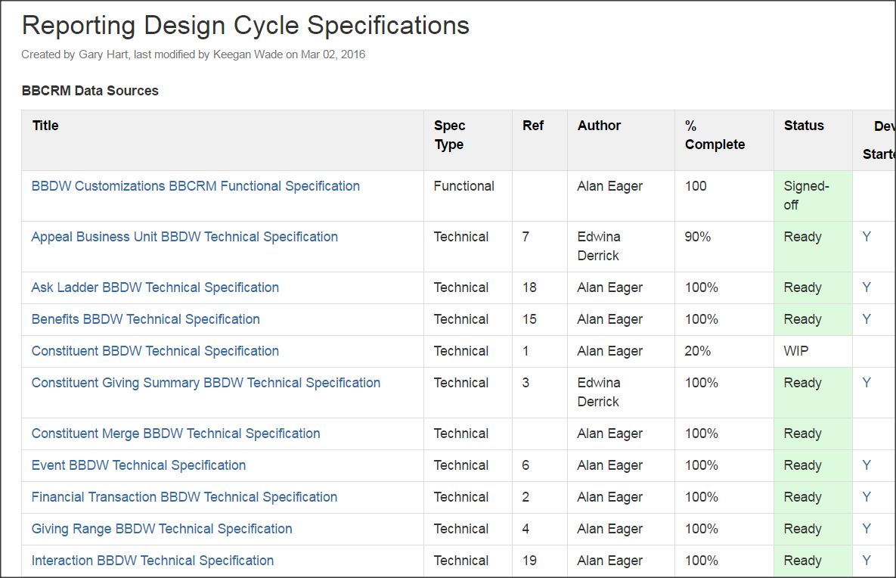
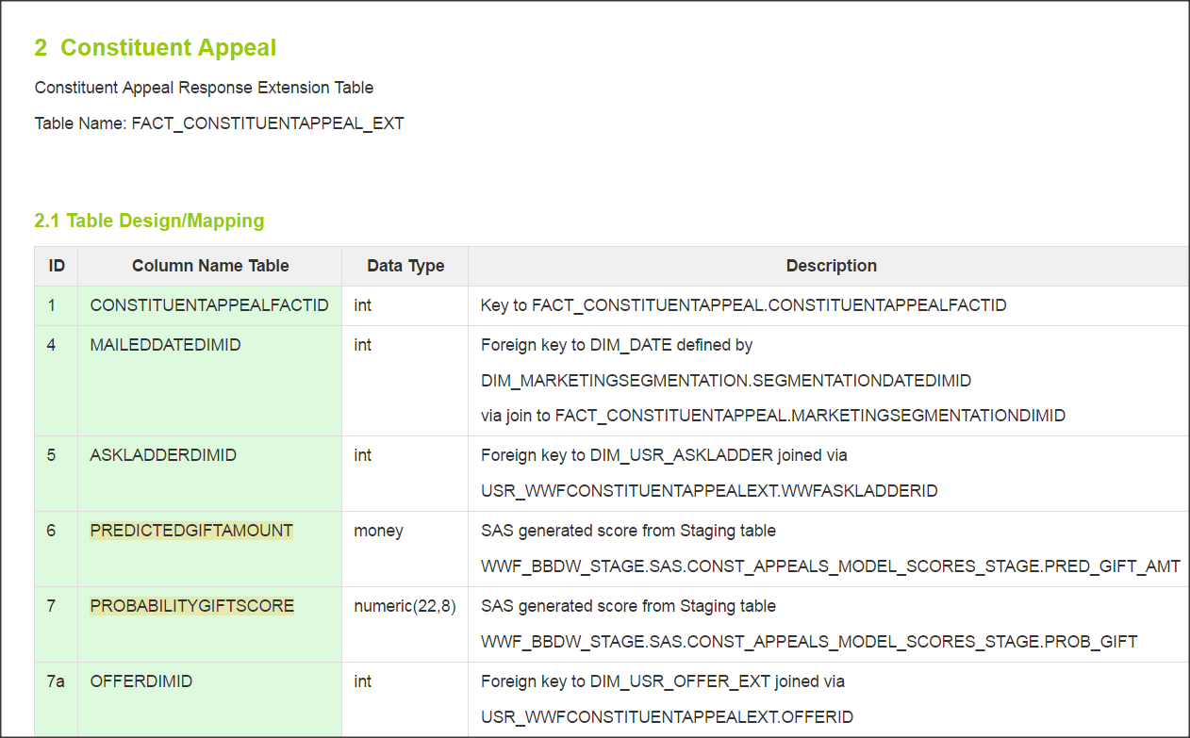
DESIGN PROCESSES

Slide 23
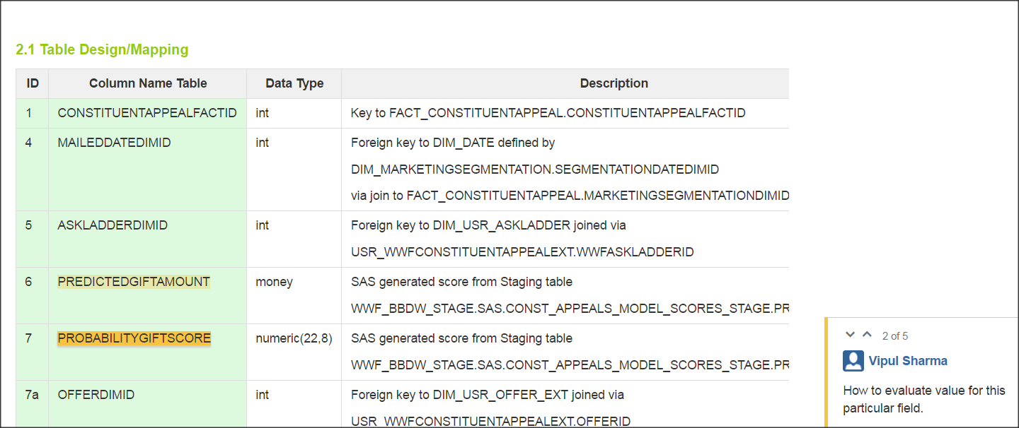
REVIEW PROCESSES
Is this a calc or materialized column?

Slide 24
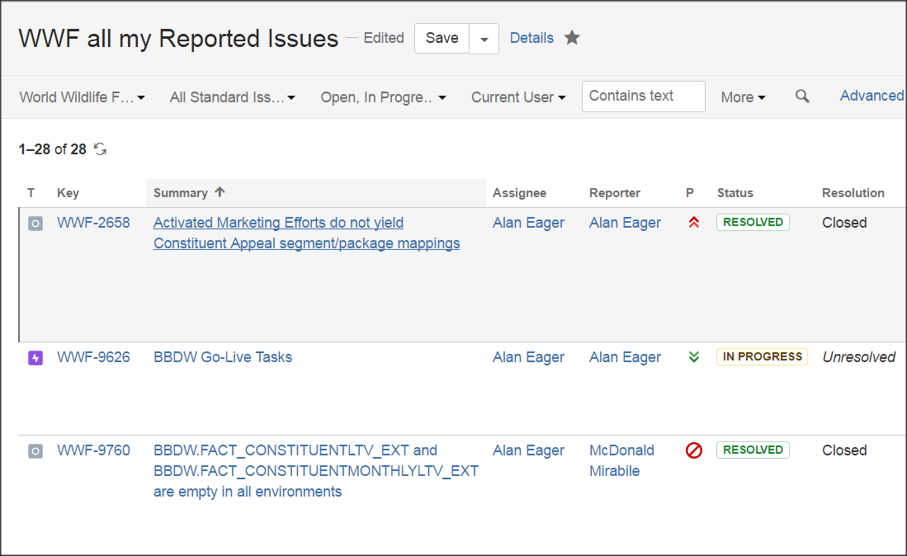
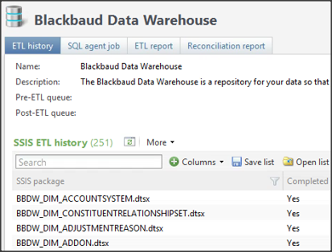
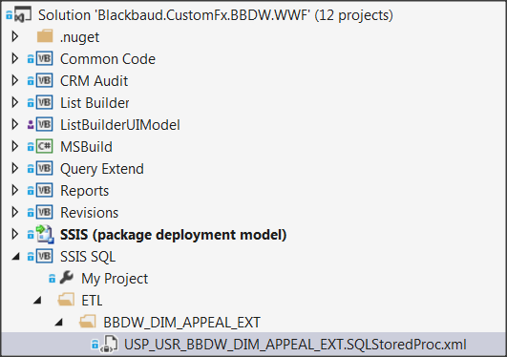
Sprint Planning & Issue Management
Design
Process
Dev

Slide 25
Divider Slide Subtitle for divider slide
Multi-Source
Technical Context

Slide 26
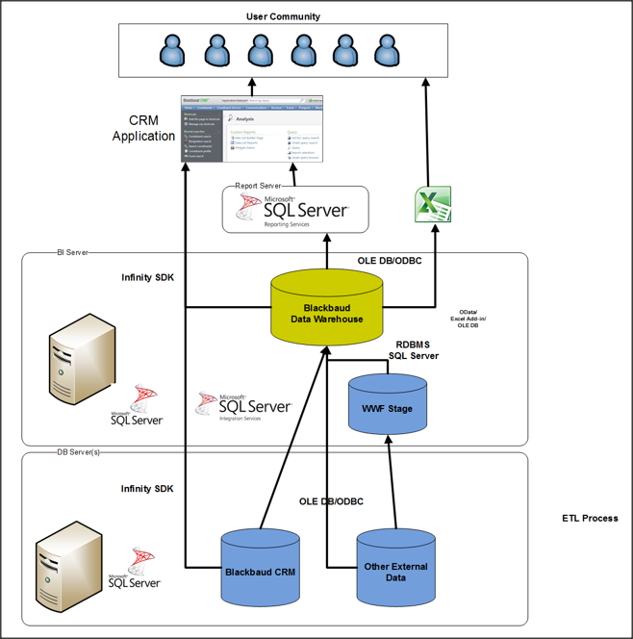

Slide 27
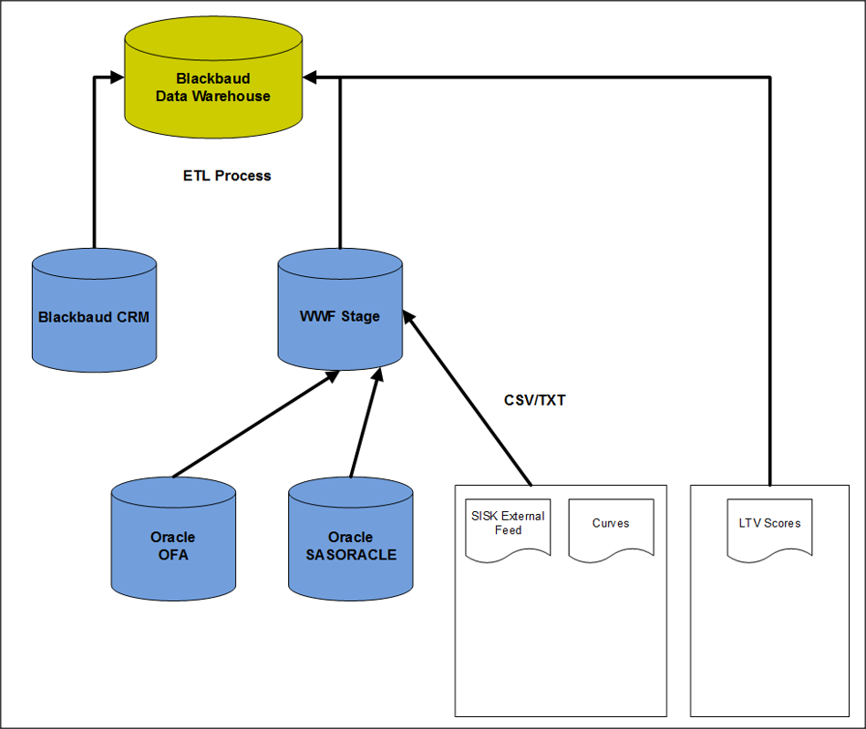

Slide 28
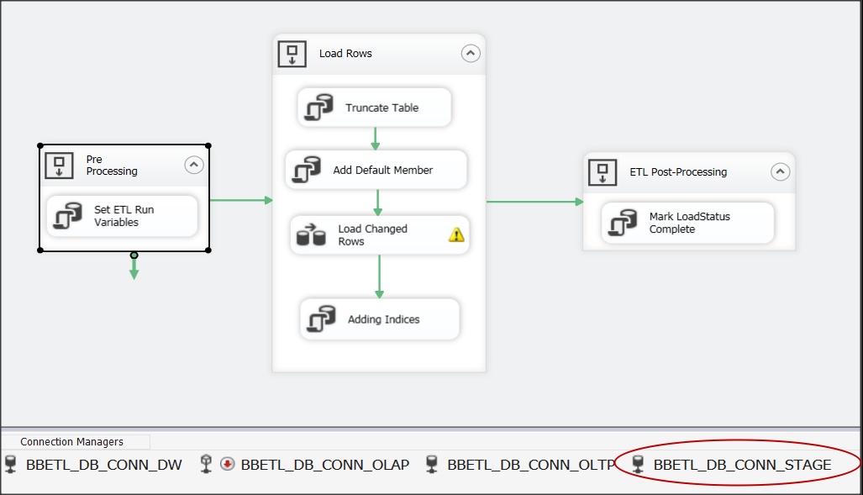
MULTI-SOURCE SSIS CONFIGURATIONS

Slide 29
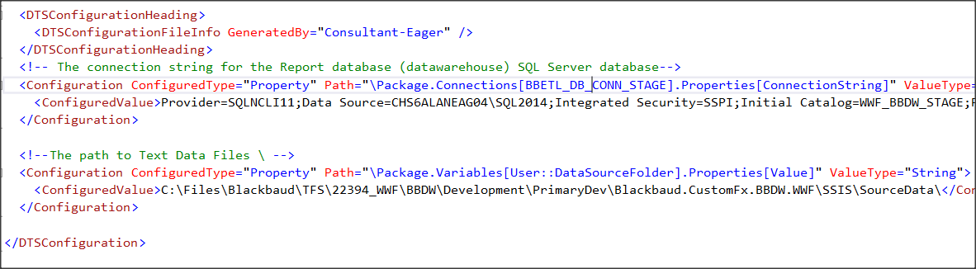
MULTI-SOURCE SSIS CONFIGURATIONS
BBETL_DB_CONN_STAGE
Additional DB Connected to
DataSourceFolder
Directory/File location for txt/csv files

Slide 30
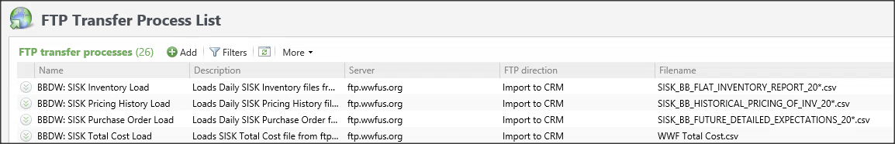
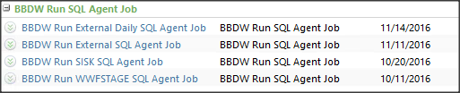
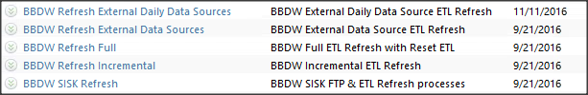
MULTI-SOURCES in BBCRM

Slide 31
Divider Slide Subtitle for divider slide
Development & QA
Tools, Techniques & Best Practices

Slide 32
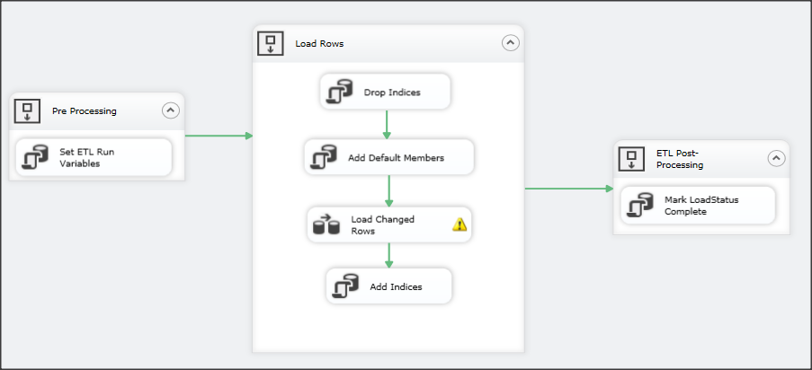
SSIS STANDARD Package
Our SSIS Packages are now very standardized
Standard USPs
Custom USP

Slide 33
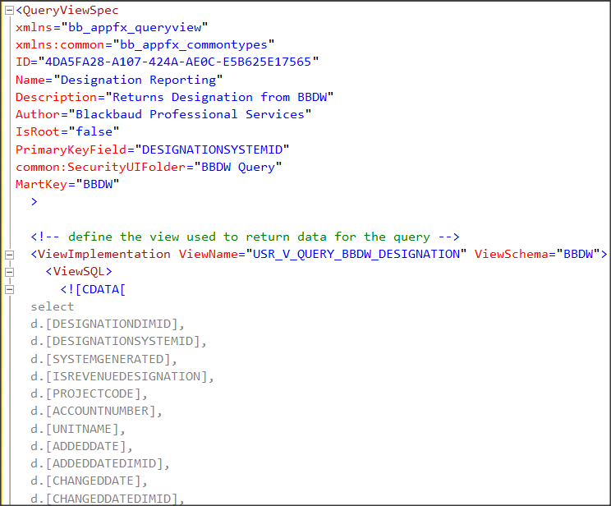

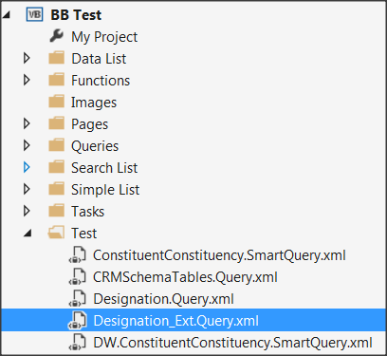
Code Generation/Automation
exec [BBDW].[USP_USR_CREATE_QUERYVIEW_EXTENSION] 'DIM_DESIGNATION_EXT', 1

Slide 34
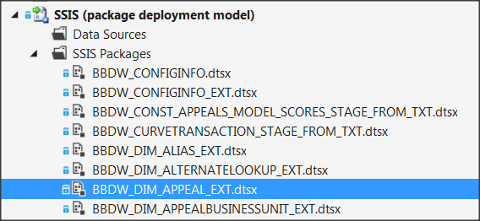
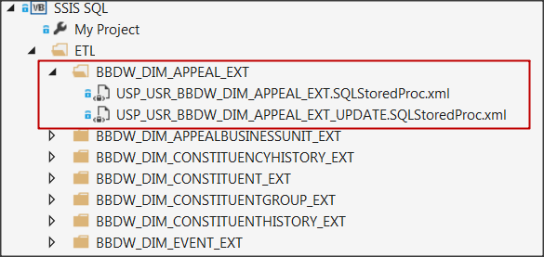
MANAGING SSIS CODE in STORED PROCS
USP_USR_<Process>
USP_USR_<Process>_UPDATE
USP_USR_<Process>_UPSERT
USP_USR_<Process>_LOOKUP
USP_USR_<Process>_DELETE
USP_USR_<Process>_WRITETOCRM

Slide 35
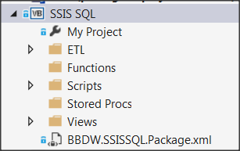
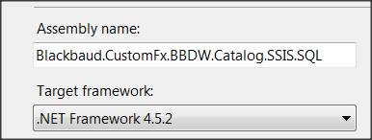
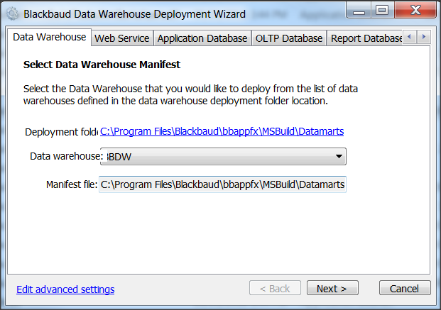
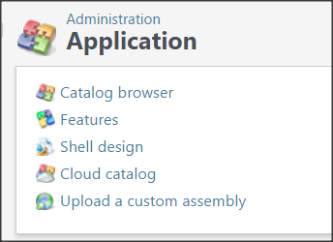

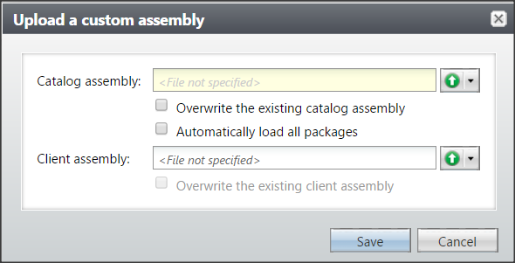
MANAGING SSIS CODE in STORED PROCS
Blackbaud.CustomFx.BBDW.Catalog.SSIS.SQL.dll
Build

Slide 36
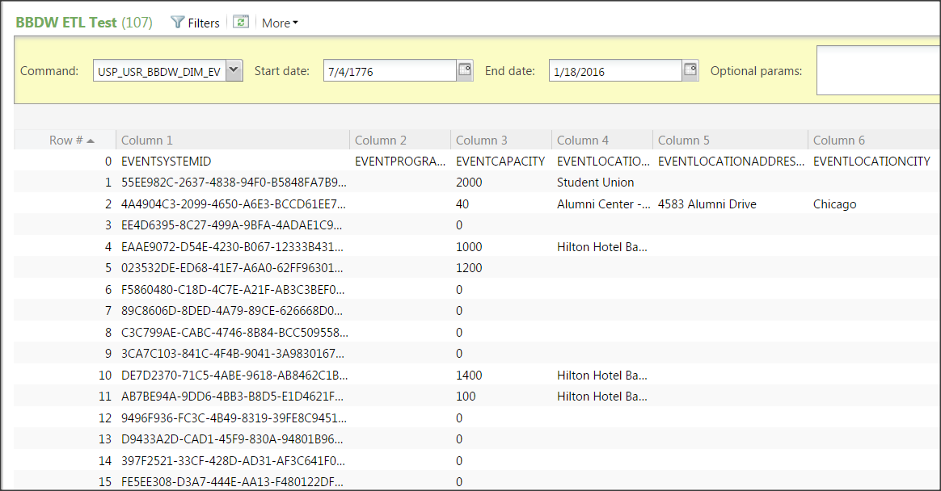
ETL QA PROCESS
USP Call

Slide 37
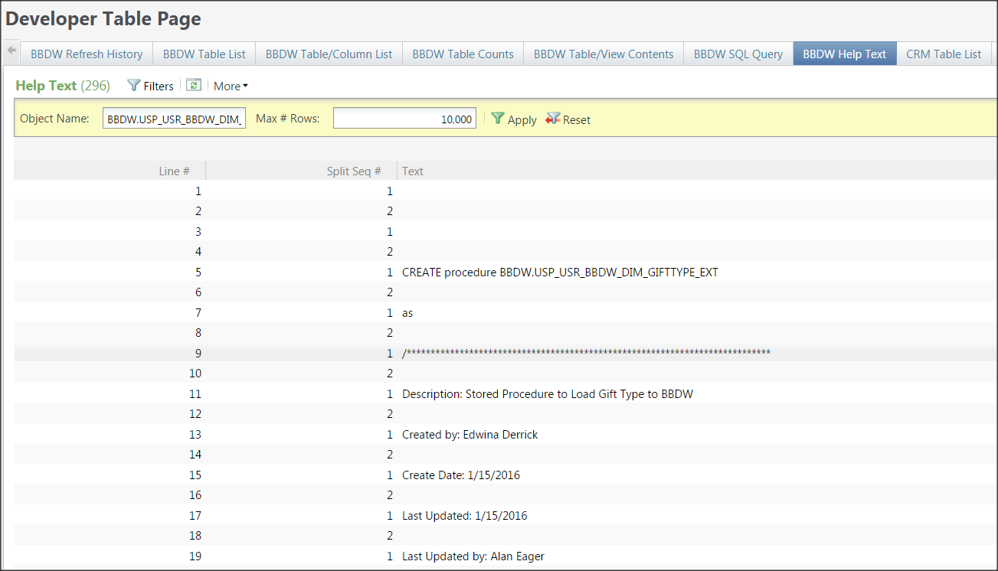
ETL QA PROCESS

Slide 38
Divider Slide Subtitle for divider slide
Deployment Processes
ETL Management

Slide 39
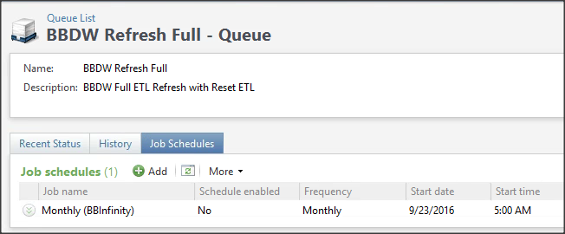
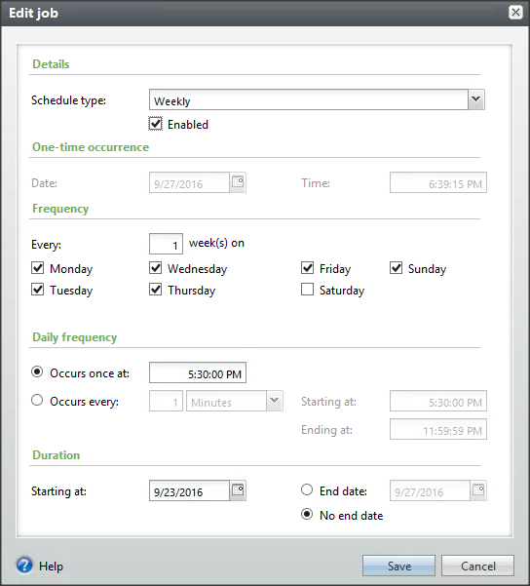
MANAGING ETL PROCESSES
Use of Queue & Scheduling BBCRM Functionality
Utilize Out-of-Box BBDW Refresh
Write Custom “Global Change” specs

Slide 40
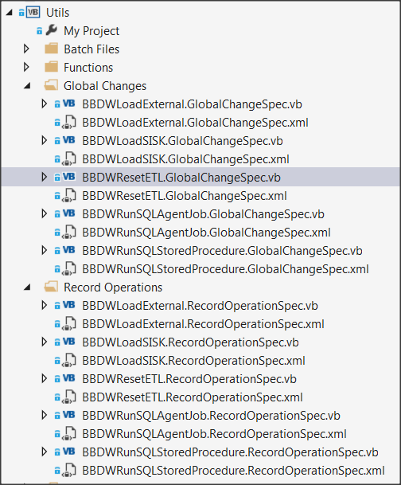
ETL PROCESS AS A Global Change Spec

Slide 41
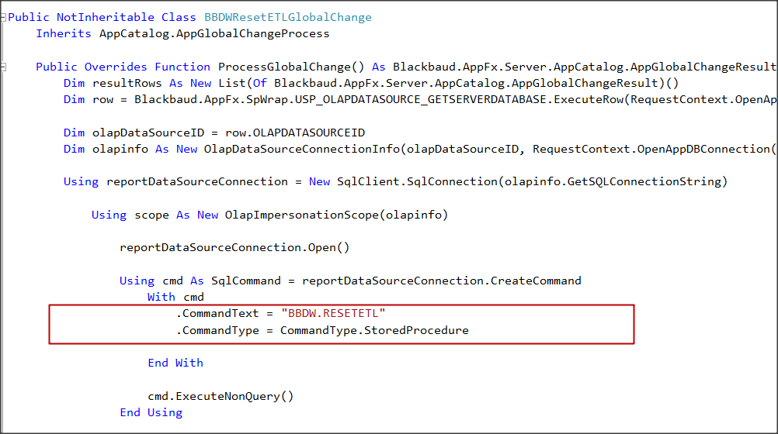
Global Change Spec

Slide 42
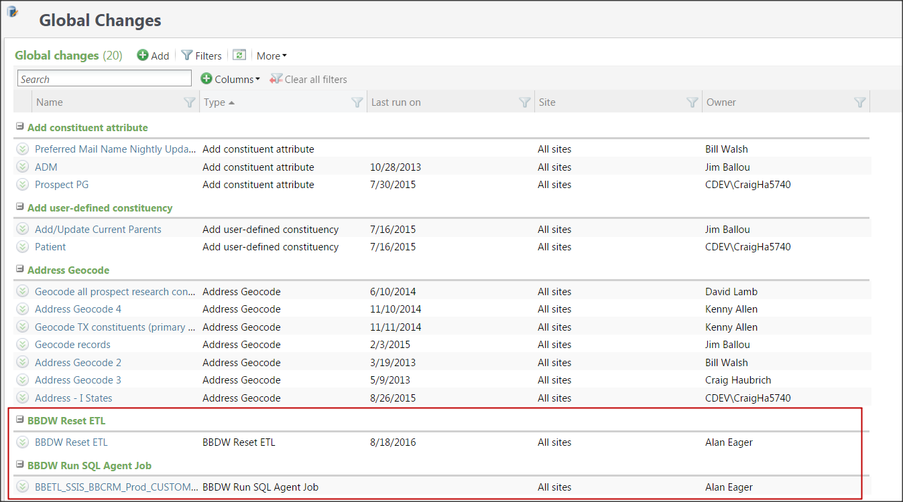
Global Changes in ADMIN

Slide 43
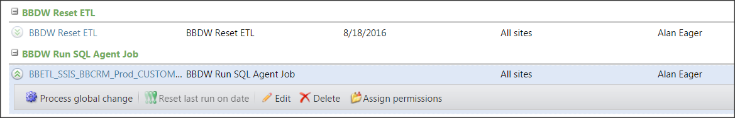
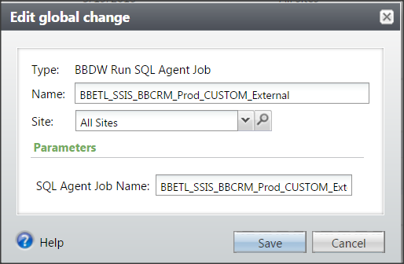
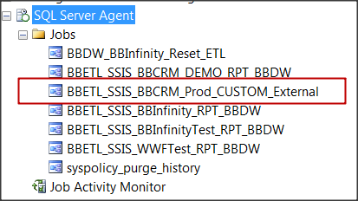
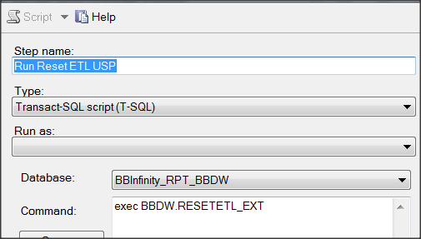
EDIT SQL AGENT JOB

Slide 44
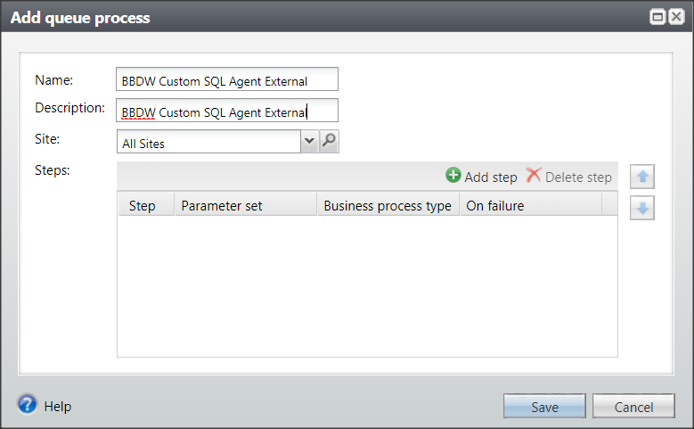
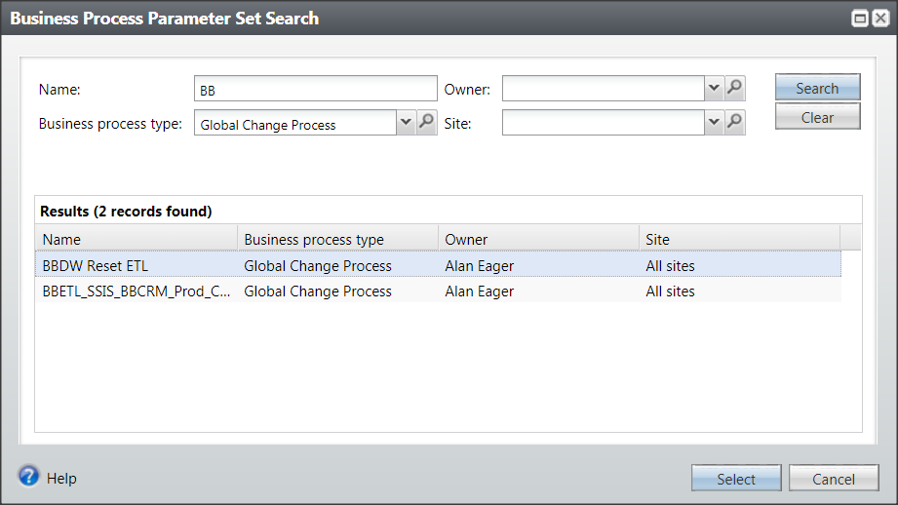
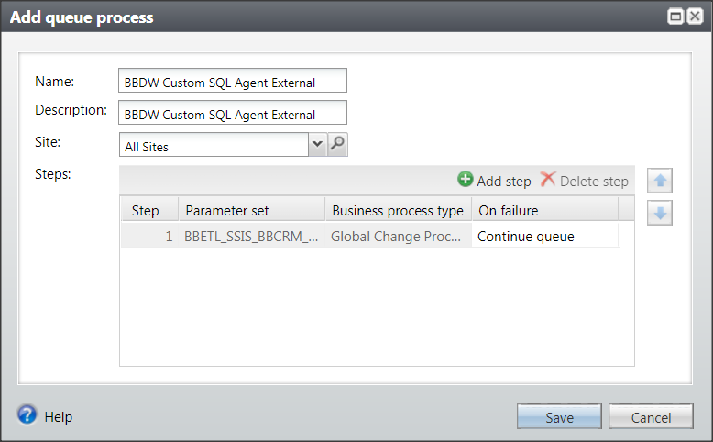
ADD to QUEUE

Slide 45
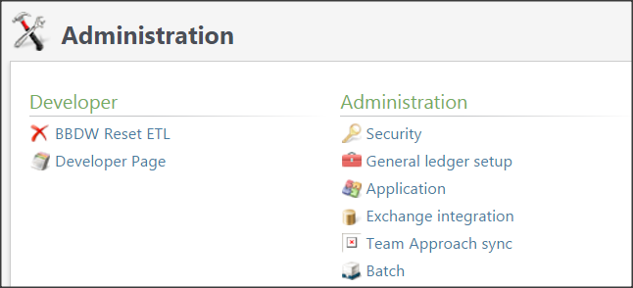
Record Operation Spec
Similar to Global Change Spec
Used to link onto a CRM Page
Link onto BBCRM Page

Slide 46
To Summarize
Collaborative Tools for Planning, Sprints (Project Mgt), Design
Use SSIS Configurations to manage multiple data sources
Modularize and separate ETL Code into USP/View/UFN Specs
Pre-built Developer Tools & Code Generators
Manage ETL Processes using Global Change & Record Set Specs
BBDW Strategic Baseline Solution

Slide 47
Social Goodness
@AlanEager
John.Schwass@WWFUS.ORG
Alan.Eager@BLACKBAUD.COM
@aeager67
Facebook.com/alan.eager
https://www.linkedin.com/in/alaneager

Slide 48


Thank you!

